Slide 1


Mobile Phone Security
Dr. Digvijaysinh Rathod
Associate Professor
(Cyber Security and Digital Forensics)
Institute of Forensic Science
Gujarat Forensic Sciences University
digvijay.rathod@gfsu.edu.in

Slide 2
Session - II
Session – II
Android Application framework
Android Application Folder Structure
AndroidManifest.xml
Resource
Activity
Intent
Dr. Digvijaysinh Rathod

Slide 3


Reference
www.developer.google.com
digvijay.rathod@gfsu.edu.in

Slide 4
Android Application Development Lab Confi.
Install JDK – Java Development Kit : Latest is Java SE Development Kit 8 for 32 bit / 64 bit download – download from oracle side.
Download Android Studio –www.developer.android.com. This is also useful to refer and documentation related to android cocepts.
Dr. Digvijaysinh Rathod

Slide 5
Android Application Components
Four main component that can be used within an Android Application
Activity – UI and handle user integration with mobile phone.
Service – Background processing associated with android application.
Broadcast Receivers – Handle communication between Android OS and Applicaton.
ContentProviders- handle data and database managements operations.
Dr. Digvijaysinh Rathod

Slide 6
Android Application Components Example
Alarm Application
You open the alarm application and set the alarm using UI – Activity
Data will be saved – ContentProviders
Service which continuously looking in the background for set time – Service
Once set alarm time matched, alarm event will ring the alarm – Event handling – Broadcast Receiver
Dr. Digvijaysinh Rathod

Slide 7
Android Application- Demo
Create new android application.
Project
AndroidManifest.xml
Dr. Digvijaysinh Rathod

Slide 8
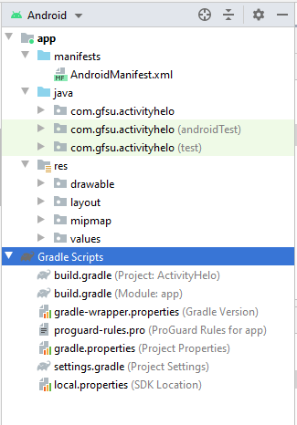
Android Application Framework
1
3
2
4
5
6
Dr. Digvijaysinh Rathod

Slide 9
Android Application Framework
App Manifest Overview
Every app project must have an AndroidManifest.xml file (with precisely that name) at the root of the project source set.
The manifest file describes essential information about your app to the Android build tools, the Android operating system, and Google Play.
Manifest file is required to declare the following:
The components of the app, which include all activities, services, broadcast receivers, and content providers.
Dr. Digvijaysinh Rathod

Slide 10
Android Application Framework
App Manifest Overview
Manifest file is required to declare the following:
The app's package name, which usually matches your code's namespace. The Android build tools use this to determine the location of code entities when building your project.
The permissions that the app needs in order to access protected parts of the system or other apps.
The manifest file is also where you can declare what types of hardware or software features your app requires, and thus, which types of devices your app is compatible with.
Dr. Digvijaysinh Rathod

Slide 11
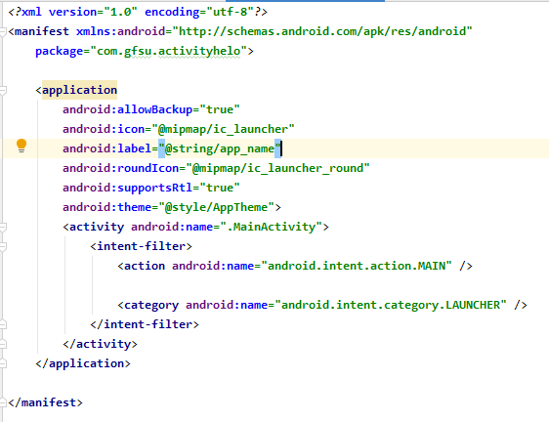
Android Application Framework - Example
Points to be discussed – with empty activity
AndroidManifest.xml
1
2 - Which other tag we can use here?
<activity>elements for activities
<service> elements for services
<receiver> elements for broadcast receivers
<provider> elements for content providers
Dr. Digvijaysinh Rathod

Slide 12
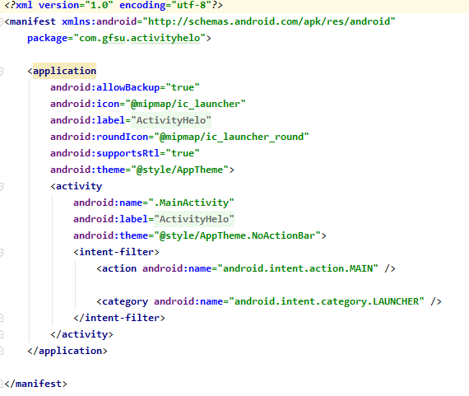
Android Application Framework - Example
Points to be discussed – with one activity
AndroidManifest.xml
Dr. Digvijaysinh Rathod

Slide 13
Android Application Framework - Android Application Component
Points to be discussed – with one activity
AndroidManifest.xml
Following is the list of tags which you will use in your manifest file to specify different Android application components −
<activity>elements for activities
<service> elements for services
<receiver> elements for broadcast receivers
<provider> elements for content providers
Dr. Digvijaysinh Rathod

Slide 14
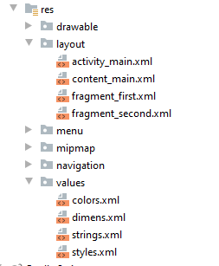
Android Application Framework - App resources overview
Resources are the additional files and static content that your code uses, such as bitmaps, layout definitions, user interface strings, animation instructions, and more.
drawable/Bitmap files (.png, .9.png, .jpg, .gif)
layout/XML files that define a user interface layout.
menu/XML files that define app menus, such as an Options Menu, Context Menu, or Sub Menu.
values/XML files that contain simple values, such as strings, integers, and colors.
Ref: https://developer.android.com/guide/topics/resources/providing-resources
Dr. Digvijaysinh Rathod

Slide 15
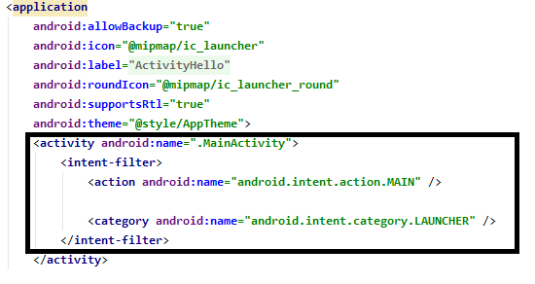
Android Application Framework - Activity
An activity represents a single screen with a user interface just like window or frame.
Dr. Digvijaysinh Rathod

Slide 16
Android Application Framework - Activity
An activity represents a single screen with a user interface just like window or frame.
An application can have one or more activities without any restrictions.
Every activity you define for your application must be declared in your AndroidManifest.xml file and
the main activity for your app must be declared in the manifest with an <intent-filter> that includes the MAIN action and LAUNCHER category.
Dr. Digvijaysinh Rathod

Slide 17
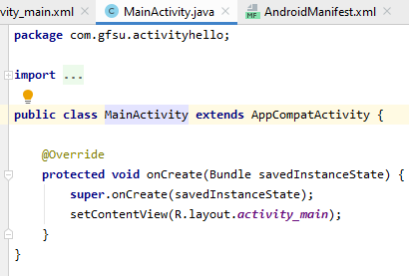
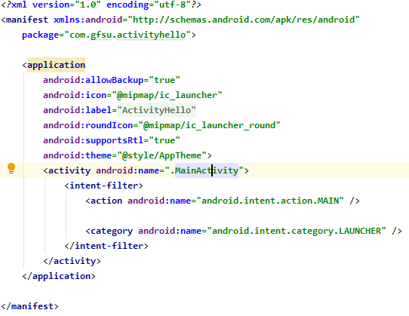
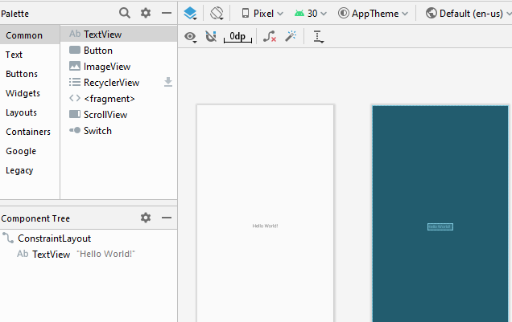
Android Application Framework - Activity
Dr. Digvijaysinh Rathod

Slide 18
The application framework : Intent
An Intent is a messaging object you can use to request an action from another app component.
Although intents facilitate communication between components in several ways, there are three fundamental use cases:
It can be used with startActivity to launch an Activity, broadcastIntent to send it to any interested BroadcastReceiver components, and startService(Intent) or bindService(Intent, ServiceConnection, int) to communicate with a background Service.
Dr. Digvijaysinh Rathod

Slide 19
The application framework : Intent
An Intent object can contain the following components
Action: This is mandatory part of the Intent object and is a string naming the action to be performed.
Category : The category is an optional part of Intent object and it's a string containing additional information about the kind of component that should handle the intent.
Dr. Digvijaysinh Rathod

Slide 20
The application framework : Intent
There are two types of intents:
Explicit intents specify which application will satisfy the intent, by supplying either the target app's package name or a fully-qualified component class name.
You'll typically use an explicit intent to start a component in your own app, because you know the class name of the activity or service you want to start. For example, you might start a new activity within your app in response to a user action, or start a service to download a file in the background.
Dr. Digvijaysinh Rathod

Slide 21
The application framework : Intent
There are two types of intents:
2. Implicit intents do not name a specific component, but instead declare a general action to perform, which allows a component from another app to handle it. For example, if you want to show the user a location on a map, you can use an implicit intent to request that another capable app show a specified location on a map.
Dr. Digvijaysinh Rathod

Slide 22
Mobile Phone Security
Dr. Digvijaysinh Rathod
Associate Professor
(Cyber Security and Digital Forensics)
Institute of Forensic Science
Gujarat Forensic Sciences University
digvijay.rathod@gfsu.edu.in

